Slide 1
Customer Satisfaction Analysis
Jamilatuzzahro
http://bit.ly/Rladies-13

Slide 2

Customer Satisfaction
Will make a user-centric company by creating metrics that measure satisfaction.
Customer satisfaction is essential to keeping your current customers and retaining new ones.
Dissatisfied customers are a retention risk, and losing them will hurt your brand. so important for brands to succeed.

Slide 3
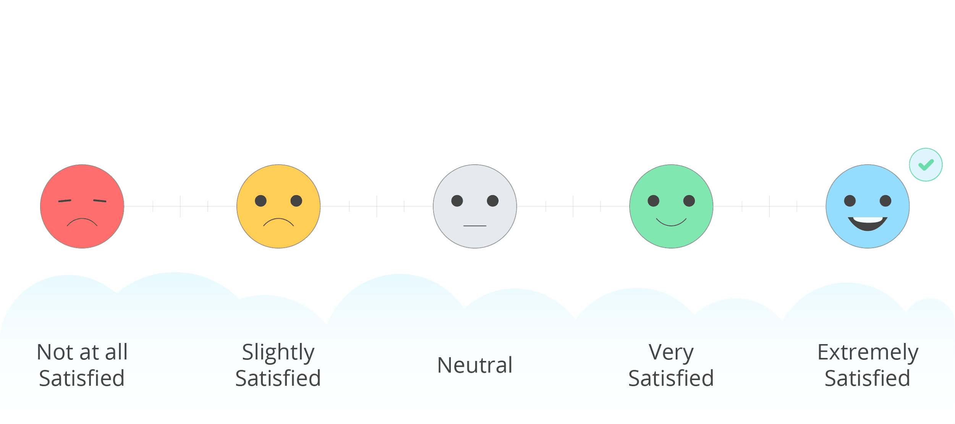
Designing a Research for Customer
Analysis Satisfaction

Slide 4












Steps in a research process
Define the research objectives
Identify target population
Specify a sampling frame & select the respondents
Choose data collection method
Create an analysis plan
Finalize the questionnaire
Pre-test the questionnaire
Design the questionnaire
Data collection
Data cleaning
Data Processing
Data Analysis & Reporting

Slide 5
What
CSAT is a study to measure overall satisfaction for each product and also give understanding on our specific performance in each journey
Why
Customize the questions to specific journey
Build long-lasting relationship with customers
Can help product team what areas should be improved
Can help marketing team which key message can be used
Research
Design
Who
Products: Fashion
Active users in the past 2 months (Based on period)
When
Survey will be sent after a customer’s experience the product
Fieldwork stage: Sep - Oct, 2020
Where
Google form link
How
Questionnaire: Divided by modules (Main and Modular, where Modular is rotated to maintain the length of interview)

Slide 6
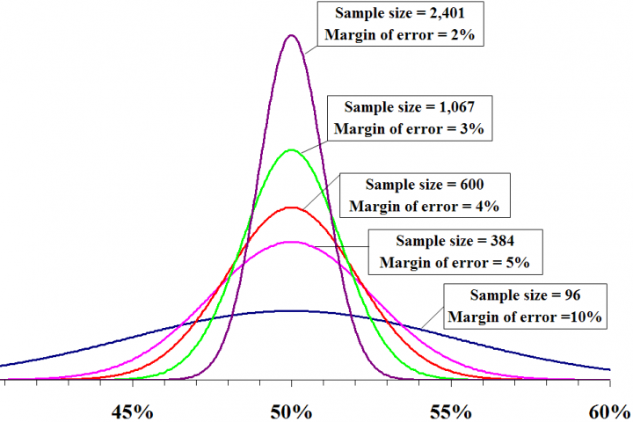
Determine the sample size
Sample size and trade of in margin of error
Rule of thumb for: confidence level = 95%
Population > 100.000
Sampling calculator: https://www.surveysystem.com/sscalc.htm

Slide 7
Determine the sample size
Sample size and trade of in margin of error
10% Margin of Error (MoE)
Example:
Based on a survey, 70% of surveyed respondents consume 1 tbs of sugar every week. With 10% margin of error, this means the proportion of Indonesian adults (population) that consume 1 tbs of sugar every week is range from 60% - 80%.
60%
Survey result
70%
80%
Estimate population

Slide 8
Determine the sample size
Sample size and trade of in margin of error
5% Margin of Error (MoE)
Example:
Based on a survey, 70% of surveyed respondents consume 1 tbs of sugar every week. With 5% margin of error, this means the proportion of Indonesian adults (population) that consume 1 tbs of sugar every week is range from 65% - 75%.
65%
Survey result
70%
75%
Estimate population

Slide 9
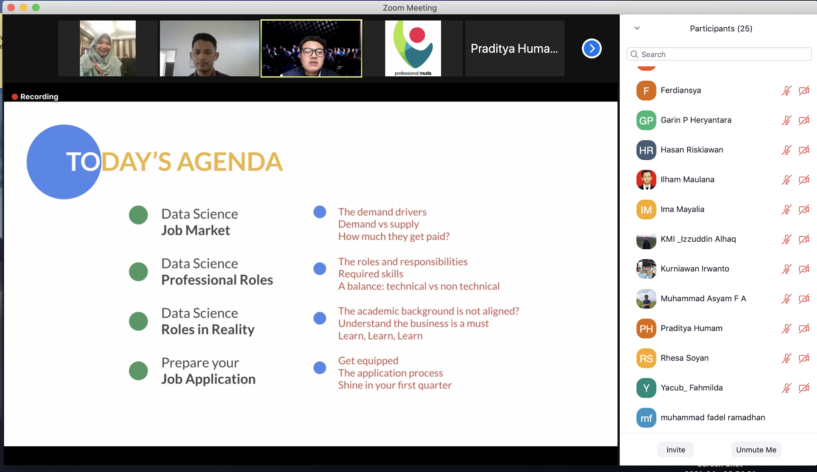


Slide 10
Designing Indicators

Slide 11
dependent
variable
independent
variable (level-1)
independent
variable (level-2)
Overall satisfaction
How satisfied are you with our product?
General indicators
Product quality
Service quality
price
accessibility
specific indicators
Product quality
teste
performance
realiability
likert scale ( 1-5)
likert scale ( 1-5)
likert scale ( 1-5)

Slide 12
Dependent Variables
Independent Variables
Additional Info (Nice to have)
All Respondents | All Respondents | Rotation based on module
Overall Satisfaction | Product Quality | Teste
 |  | performance
 |  | reliability
 | Service Quality
 | Price
 | accessibility
NPS
Demographic (Age, gender)

Slide 13
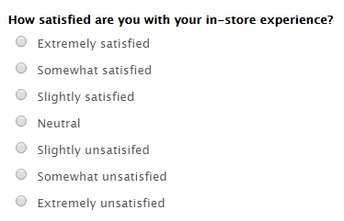
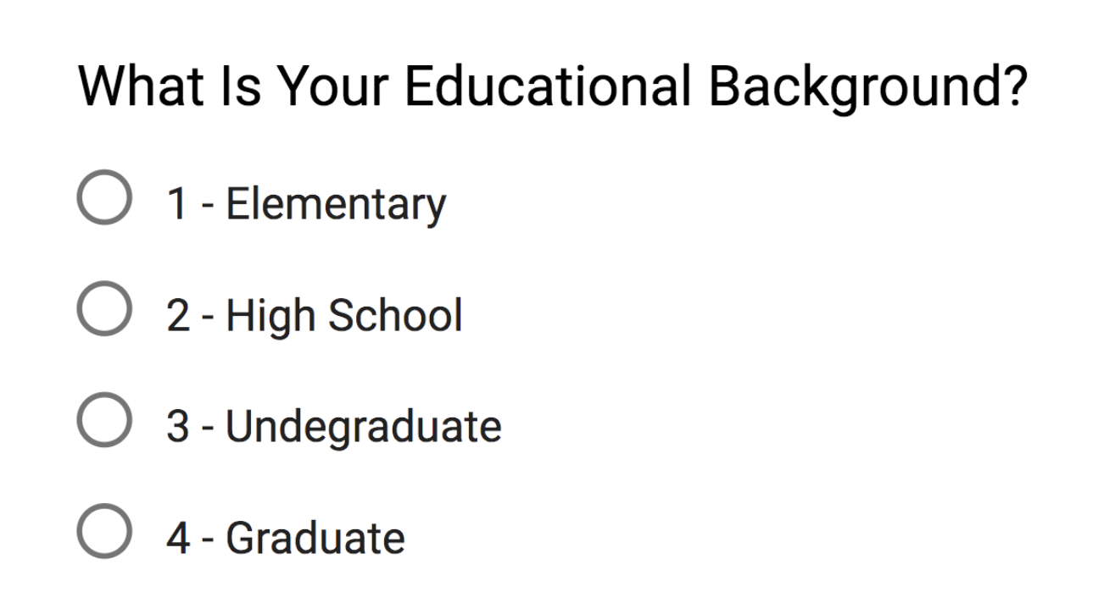
Ordinal Data
Ordinal values represent discrete and ordered units. ordinal scales are usually used to measure non-numeric features like happiness, customer satisfaction and so on
Example :

Slide 14
Ordinal data is a kind of categorical data with a set order or scale to it

Slide 15
Data Analytics
Using R Software

Slide 16
Impact : Beta Weight
Beta weight is best used as an initial ― starting point from which to begin exploring the issue of independent variables contributions to a dependent variable. It can provide an initial rank ordering of variable contributions.
(e.g., Courville & Thompson, 2001; Nimon, Gavrilova, & Roberts, 2010; Zientek, Capraro, & Capraro, 2008).
Measure contribution of each attribute (independent) to overall satisfaction performance

Slide 17
Impact : R Square
Measure contribution of each attribute (independent) to overall satisfaction performance

Slide 18
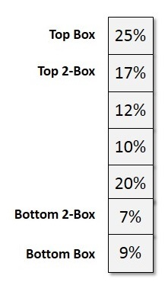
Performance : TOP Two Box Analysis
The simplest distribution would list every value of a variable and the number of persons who had each value.

Slide 19
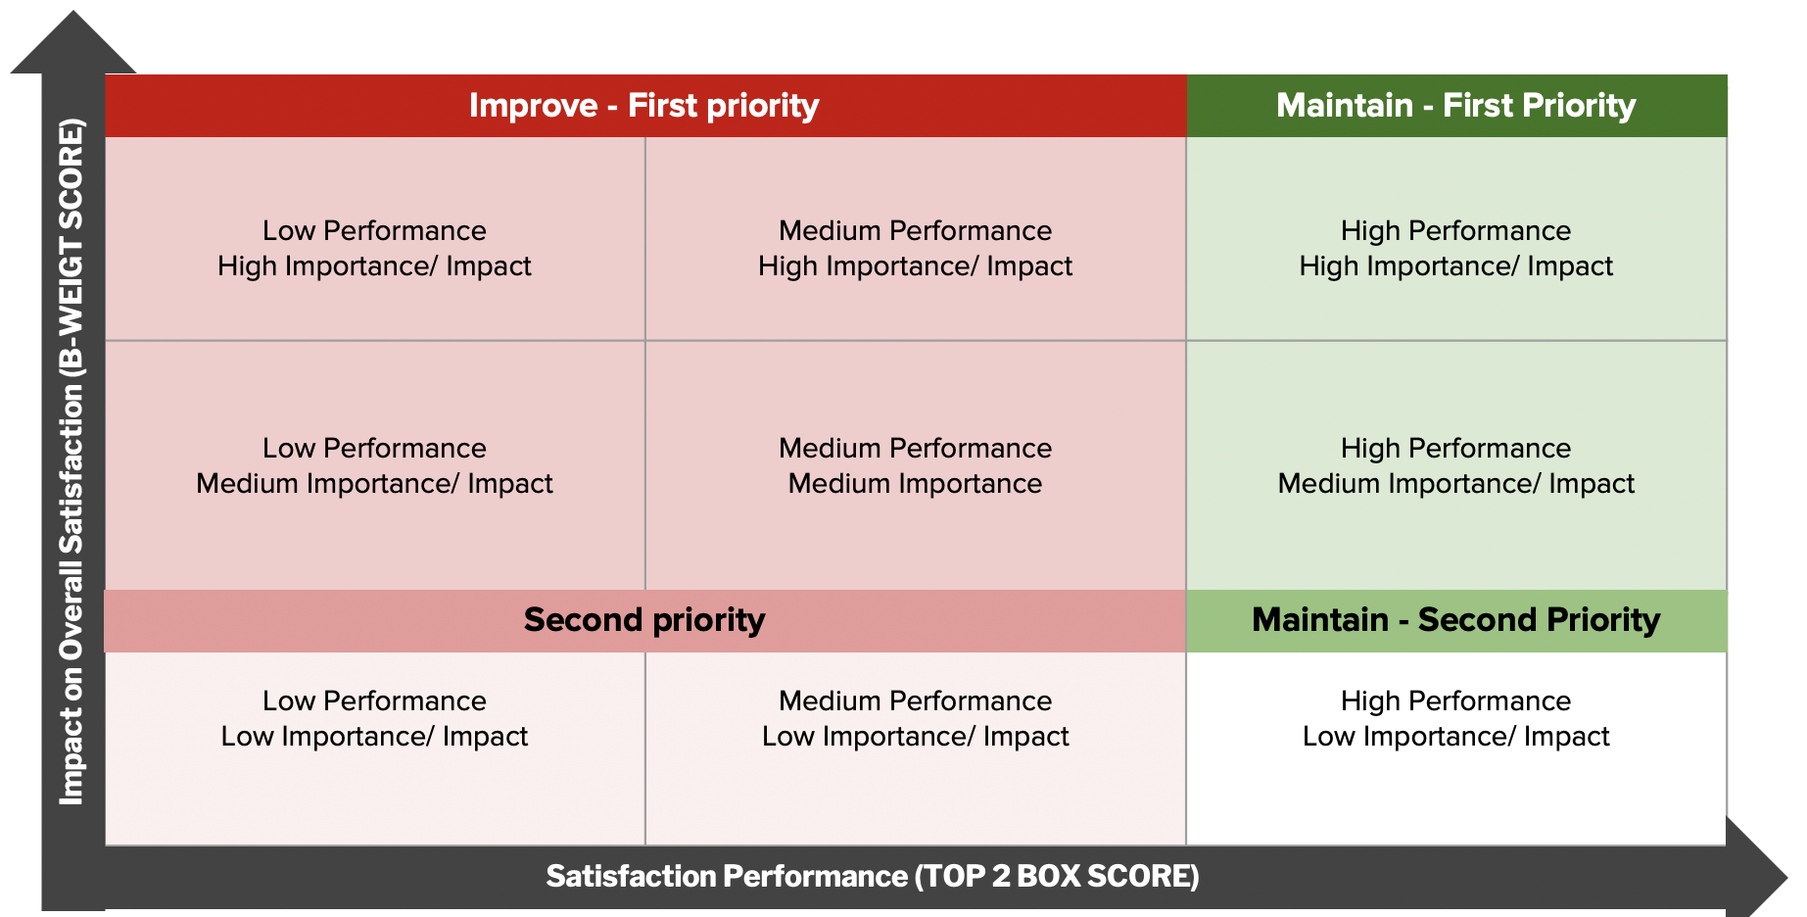
Segmentation

Slide 20

Practical Analytics using
R Software

Slide 21
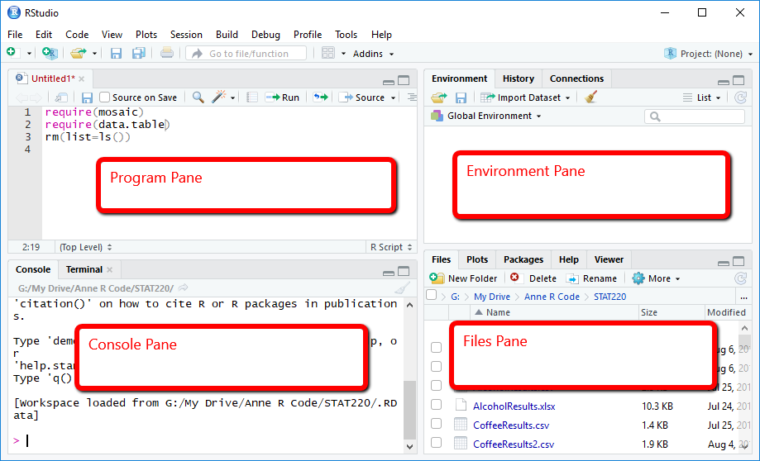

Slide 22



Notes:
https://blog.hubspot.com/service/customer-satisfaction-survey-examples

